Slide 1
Digital Portfolio
STUDENT NAME: R.RAKSHITHA
REGISTER NO :36324U18053
NMID:
DEPARTMENT: BSC (COMPUTER SCIENCE)
COLLEGE: COLLEGE/ UNIVERSITY:SREE ABIRAAMI ARTS AND SCIENCE COLLEGE FOR WOMEN THIRUVALLUR UNIVERSITY

Slide 2
PROJECT TITLE
WEB DEVELOPEMENT

Slide 3


AGENDA
Problem Statement
Project Overview
End Users
Tools and Technologies
Portfolio design and Layout
Features and Functionality
Results and Screenshots
Conclusion
3/21/2024 Annual Review

Slide 4

PROBLEM STATEMENT
Many individuals struggle to present their skills and achievements effectively. A well-structured portfolio bridges this gap by offering a clear, compelling showcase of work, enabling better opportunities, recognition, and personal growth in competitive environments.

Slide 5

PROJECT OVERVIEW
This portfolio project compiles diverse works, showcasing creativity, technical skills, and personal development. It serves as a dynamic platform to present accomplishments, reflect growth, and communicate value to potential collaborators, employers, or academic institutions with clarity and impact.

Slide 6

WHO ARE THE END USERS?
The portfolio is designed for potential employers, academic evaluators, clients, and collaborators. It also serves individuals seeking inspiration or insight into the creator’s skills, achievements, and growth—making it a valuable tool for both professional and personal audiences.

Slide 7

TOOLS AND TECHNIQUES
This portfolio utilizes a range of tools including graphic design software, coding platforms, and productivity suites. Techniques such as layout design, content curation, responsive formatting, and storytelling are employed to enhance presentation. The integration of multimedia elements and user-friendly navigation ensures an engaging experience, effectively showcasing skills and accomplishments across various domains.

Slide 8
POTFOLIO DESIGN AND LAYOUT
Showcasing a fusion of creativity and functionality, this portfolio highlights innovative design layouts tailored for digital and print media. Each project reflects a keen eye for typography, color harmony, and spatial balance. From sleek UI mockups to bold editorial spreads, the collection demonstrates versatility and precision—crafted to captivate, communicate, and elevate brand identity through compelling visual storytelling.
8

Slide 9
FEATURES AND FUNCTIONALITY
This portfolio showcases intuitive features and seamless functionality across diverse design solutions. From responsive interfaces to dynamic user interactions, each project emphasizes usability, accessibility, and performance. Smart navigation, adaptive layouts, and integrated tools reflect a user-centered approach, ensuring every experience is both engaging and efficient. The result: design that not only looks great but works brilliantly.

Slide 10
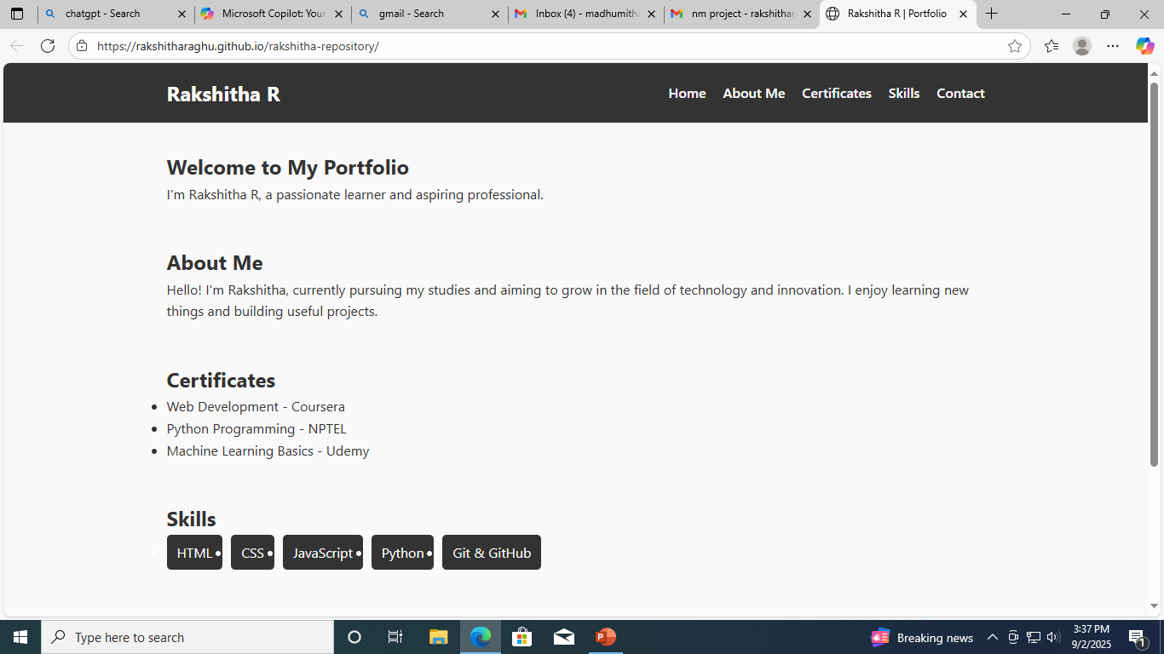

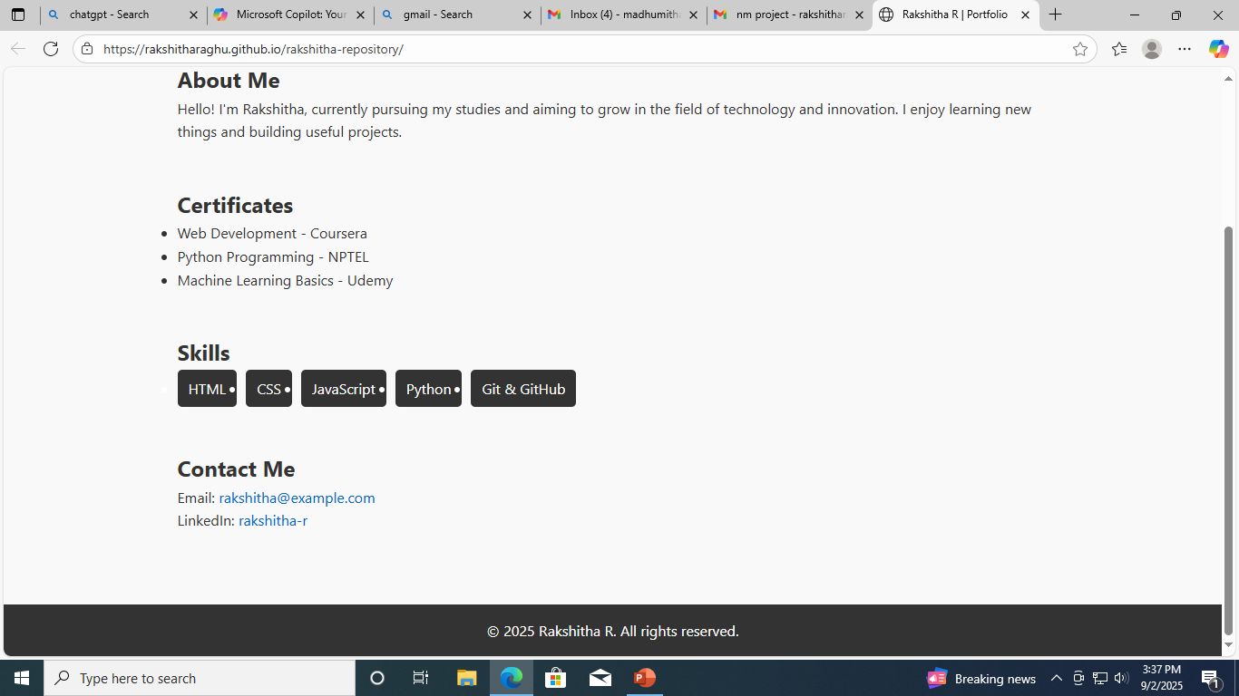
RESULTS AND SCREENSHOTS
3/21/2024 Annual Review
10

Slide 11
CONCLUSION
This portfolio reflects a journey of thoughtful design, strategic functionality, and creative innovation. Each project showcases a commitment to excellence and a passion for solving real-world challenges through visual storytelling. As the final note, it stands as a testament to growth, adaptability, and vision—ready to inspire, engage, and elevate future collaborations and opportunities.
11

